Slide 1
Wabash Capstone Project Notes 09
By: John Danison

Slide 2
What Did I Say I Would Do This Week?
Find electrical schematic software & get working locally.
Begin writing firmware outline & find proper libraries.

Slide 3
What I Have Done Over The Past Several Weeks
Wrote test firmware modules for each sensor we are using. Created a simple working prototype. See slide 4.
Found electrical schematic software in the forms of Fritzing and Altium Designer. Both options are installed and working. See slide 5.
Created more electrical documentation for new circuits. Also did calculations for battery selection and circuit power. See slide 7.
Max found strain gauges, so I created the circuitry and code needed to test these for the first time. See slide 11.

Slide 4
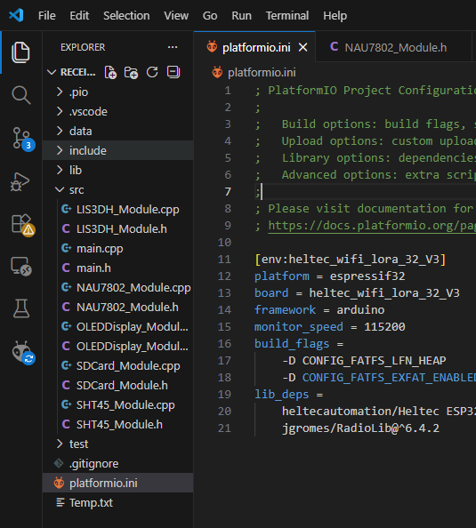
Breakdown of Code Modules

Slide 5
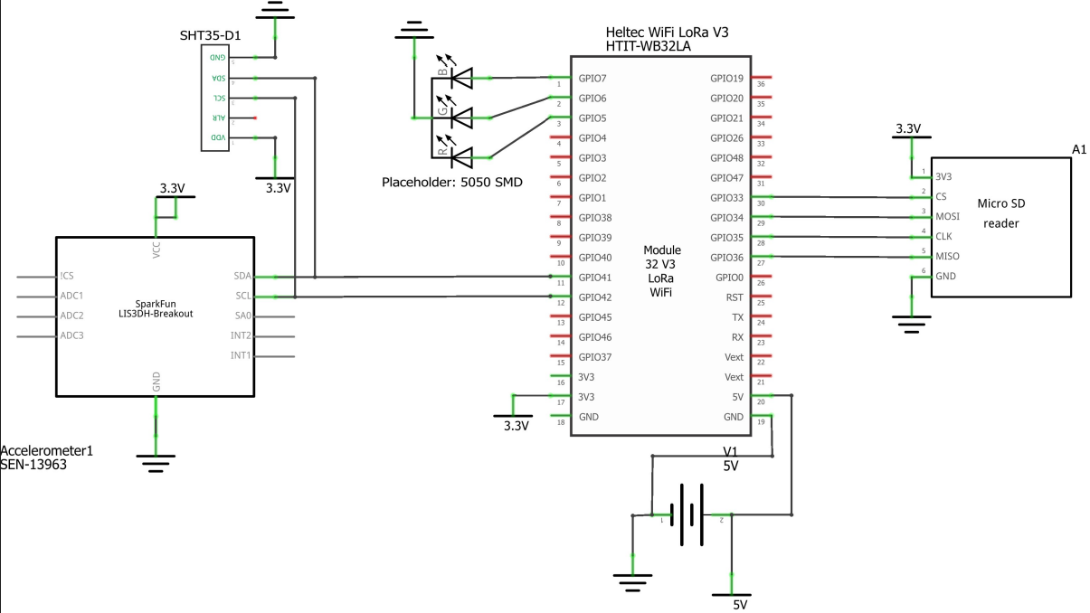

Electrical Software 1 – Fritzing

Slide 6

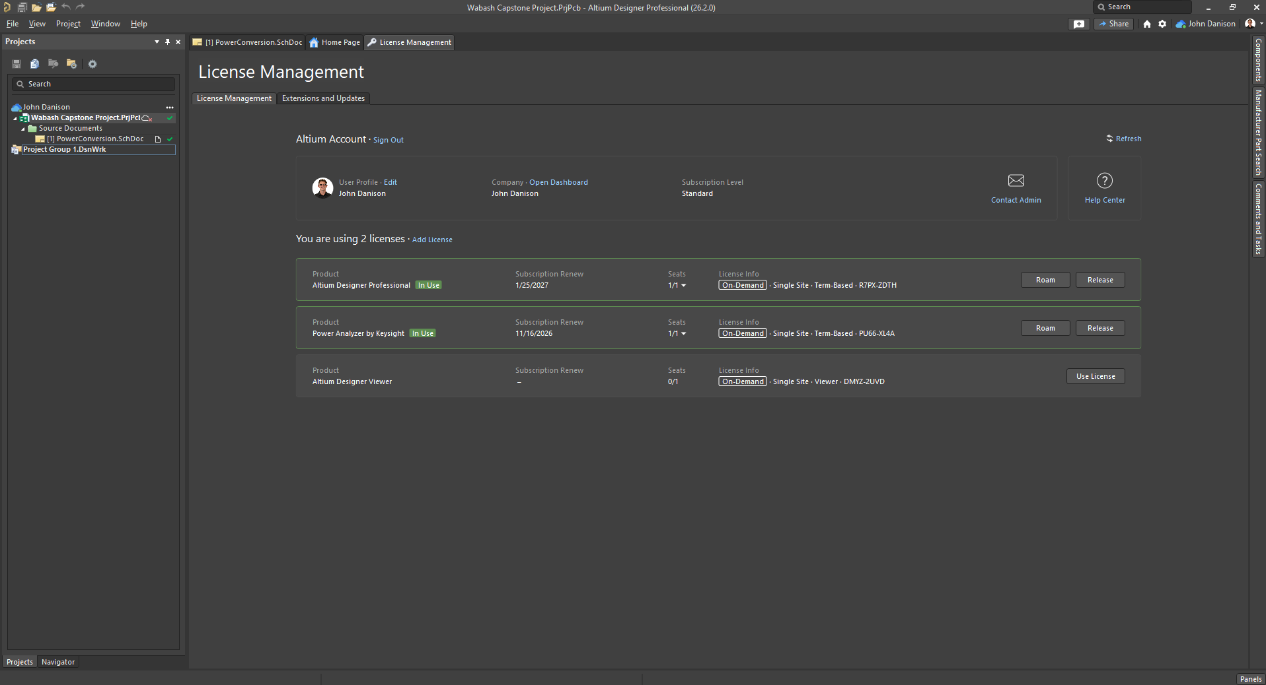
Electrical Software 2 – Altium Designer
Going forward, Altium Designer will be used.
Fritzing is good for quick simple drawings, Altium is PHENOMINAL at schematic making, PCB layouts, and more.
Nothing has been done in Altium so far, I just got it working today.

Slide 7
Summary of Current Breakdown & Battery Calculations
Current Breakdown
Battery Calculations
Component | Current (mA)
ESP32 | 20
LoRa Radio (idle) | 46
LIS3DH | 0.011
SHT35 | 0.1
microSD | 2
Total | 68.211
+10% Overhead | 75.0321
Calculation Step | Formula | Result
mAh @ 5V | 75.0321 mA × 6 months × 30 days × 24 hr | 324.139 Ah
Wh @ 5V | 324.139 Ah × 5 V | 1620.699 Wh
Wh w/ battery loss | 1620.699 Wh ÷ 0.90 | 1800.770 Wh
Ah from 12V battery | 1800.770 Wh ÷ 12.8 V | 140.685 Ah

Slide 8
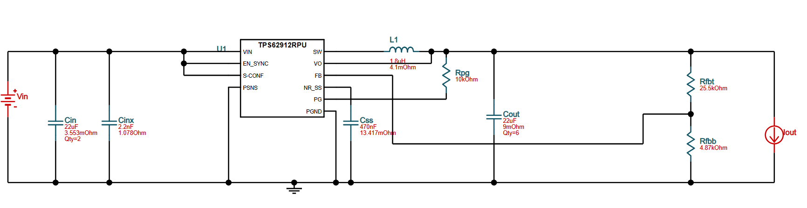


Sample Designed Power Converter
Sample 12V : 5V DC Buck Converter

Slide 9
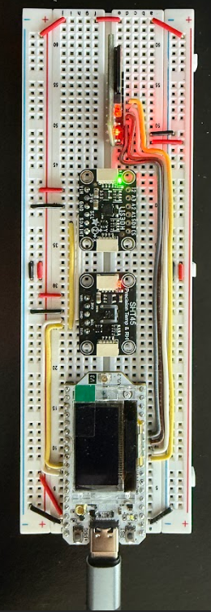
Comparison of Circuit Software & Hardware Layouts

Slide 10
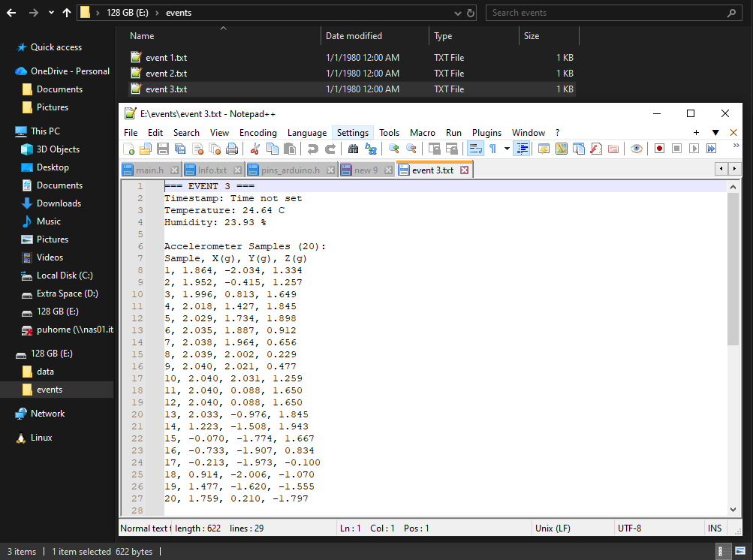
Comparison of Software Data Acquisition
Data Sample Expectations
Unoptimized Data Sample Results
Parameter | Value / Calculation | Result
Sensors | 3-axis accel + 1 strain (high-rate) + Temp & RH (1 sample) | —
Sampling Rate (Accel/Strain) | 2,000 samples/sec | —
Data Format | 16-bit (2 bytes/sample) | —
Data Rate | 2,000 × 4 × 2 | 16 kB/s
Burst Duration | — | 2 s
Burst Size (Accel + Strain) | 16 kB/s × 2 s | ≈ 32 kB
Temp + RH Samples | 2 sensors × 2 bytes each | + 4 B
Total per Burst | 32 kB + 4 B | ≈ 32 kB
128 GB microSD Capacity | ≈ 137,000 MB | —
Bursts Storable | 137,000 MB ÷ 0.031 MB | ≈ 4.3 million bursts

Slide 11
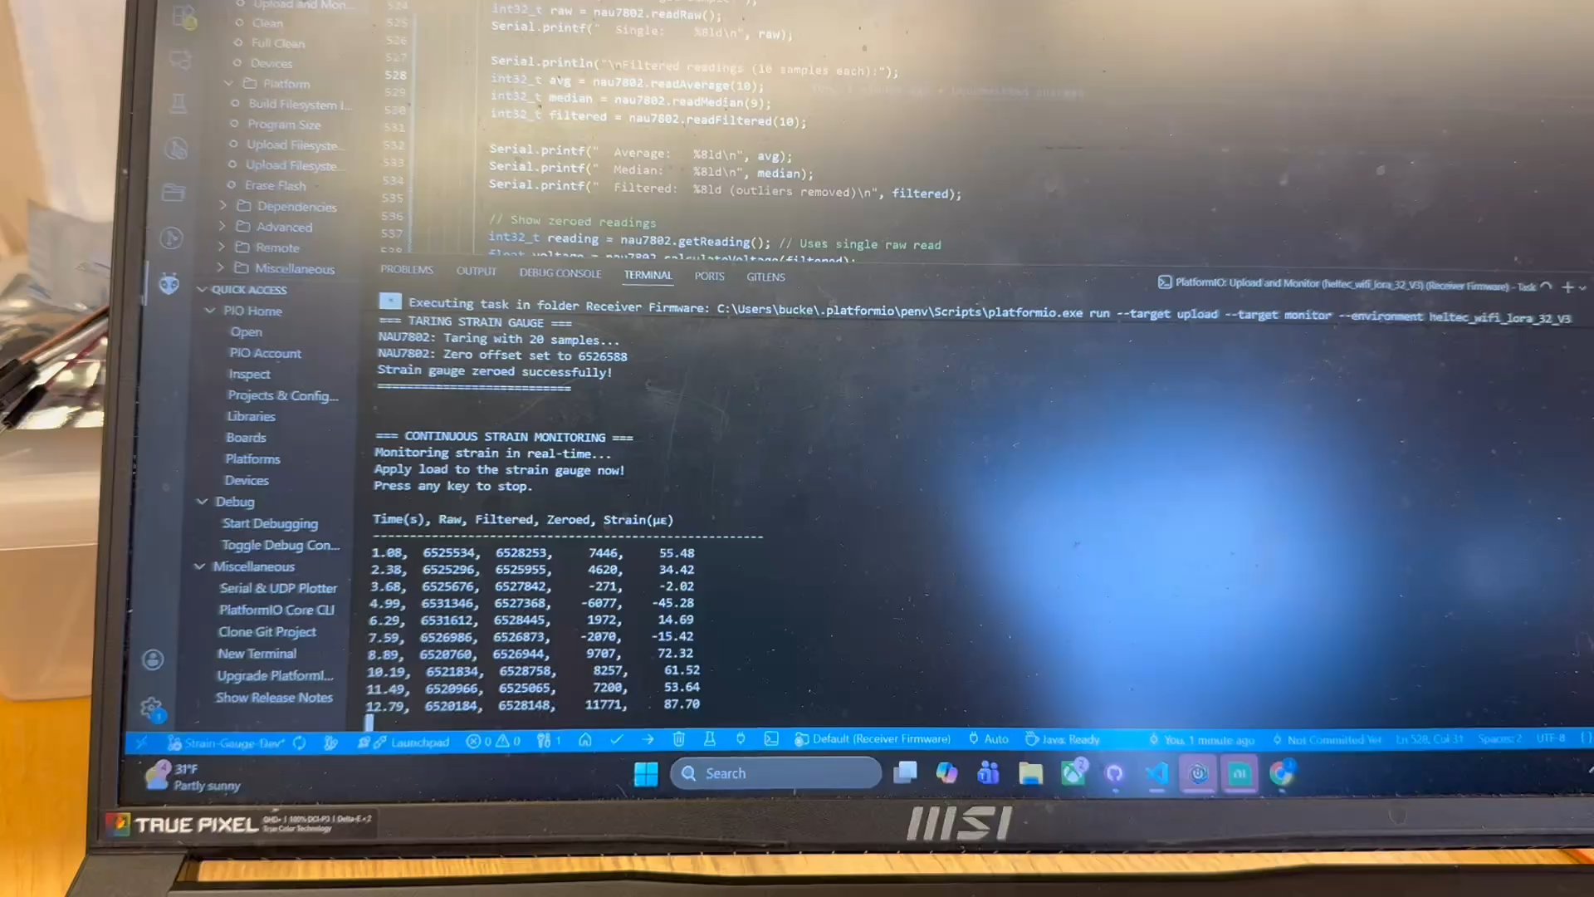
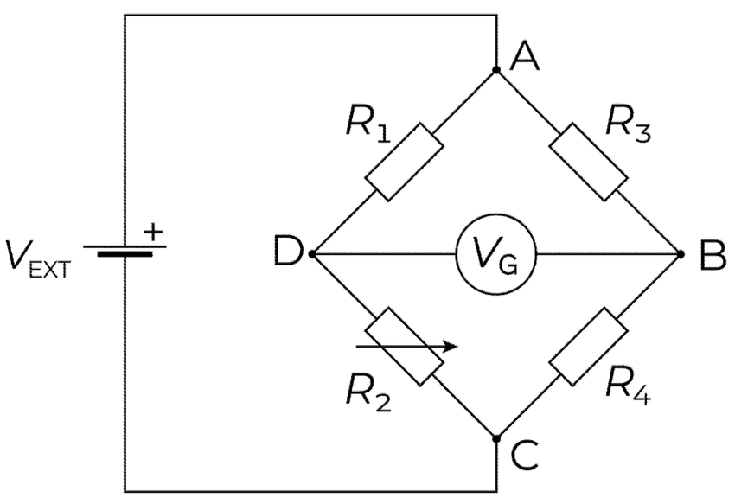

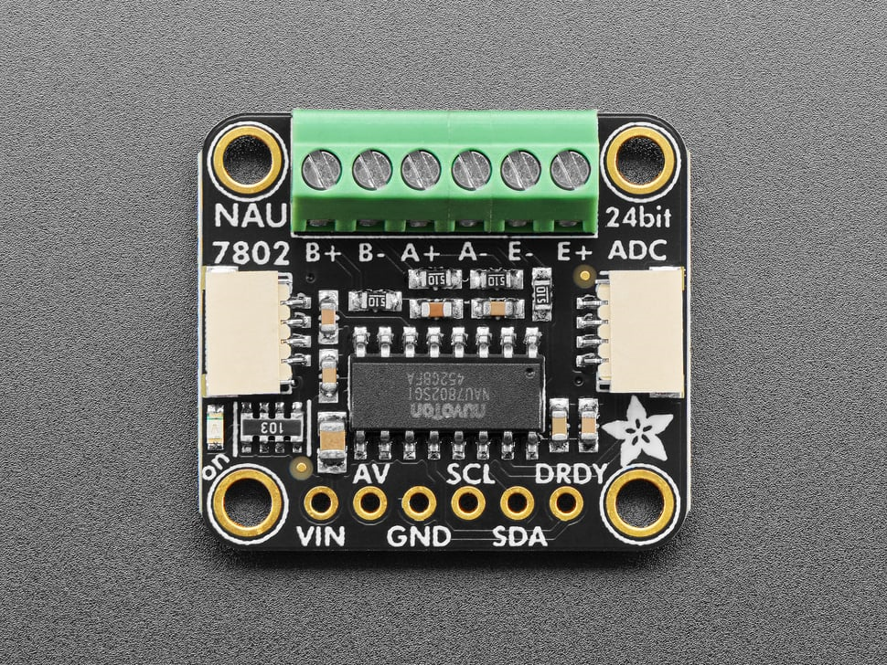
New Strain Gauge Circuitry & Demo
E+
A-
A+
E-

Slide 12
Did I Do What I Say I Would Do?
I believe that I covered everything that I said I would do. I created the firmware and circuitry required to get all sensors working.
I showed up to every lecture, lab, and meeting and contributed my knowledge with everyone.

Slide 13
Plans For Upcoming Weeks
High Level
By EOW:
Start to refine system sensors & configuration.
Learn how to use Altium Designer. Will follow tutorial videos.
Continue to show up to class.
Continue to refine the noise readings in strain gauge circuit. Figure out a reliable solution.
Begin creating schematics in Altium Designer. Need to start PCB design ASAP.

